Slide 1


Group-3:
ETL for Unstructured
Geospatial Data
Client : Lithodat Pty. Ltd.
Project Supervisors : Michael Kirley, Vivek Katial
Notes:
Slide time (10 seconds) (Jiahui)

Slide 2


Slide 3




Data Science Team
Hangzhou Wu
(Project Manager & ETL Engineer)
Kanav Sood
(Industry Partner Contact & Data Architect)
Shiv Mistry
(Team Leader, Resource Collector & ETL Tester)
Jiahui Zhu
(Project Manager & ETL Engineer)
Notes:
Slide time (20 seconds) (Jiahui)

Slide 4

Overview
Home of spatial geoscience data
Lithodat’s online intuitive platform LithoSurfer
Rise of geospatial big data Unstructured & Unorganized
Aim to make community portal for geoscience community
Vision to provide easy, accessible and fast cloud-hosted spatial DB & built-in analytics to gain valuable insights
Thus, Data Scientists needed to organize the data from various sources, structure it and make sense out of it
Notes:
Slide time (30 seconds) (Jiahui)
Talk about the research problem
Talk about their core thing (for lithodat - being hub of geospatial data)
How you use DS to solve clients problems?
Answer - key data science research questions introduced

Slide 5
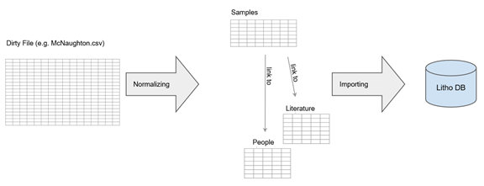
Intro - Client Problem
Geospatial data collected from various sources do not follow common format/schema
Core tasks - Data Cleaning, Data Normalization, Mapping Data to a schema followed by Lithodat & Load data into DB
Focus on Data Engineering stage of DS Pipeline
Scope of project based on Client requirements:
Semi-automated solution
ETL tool have user-friendly UI
ETL tool have shallow learning curve
Non programmable solution
Goal : Find a semi-automated ETL process to bring unstructured geological data into a structured and queryable form
Notes:
Slide time (1 min) (Jiahui)

Slide 6
Project Steps
Stage 1
(Literature Review/Related Work)
Stage 2
(Testing ETL tools)
Stage 3
(Final ETL pipeline for client)
ETL & its testing techniques
Comparison of ETL tools
Data Normalization
Challenges for the project
Pentaho Software
Tableau prep
Results of tests conducted
Design pipeline on chosen tool
Test out pipeline
Import (transformed) data to lithosurfer
Notes:
Slide time (40 seconds) (Jiahui)

Slide 7

Related Work &
Literature Review
Notes:
Slide time (5 seconds) (Shiv)

Slide 8
What is ETL?
Extraction :
Data extracted from various stored DB sources
1
Transformation :
converting extracted data into required format
2
3
Loading :
Store transformed data into target data warehouse
Approaches to ETL -
Code Based
Software Based
Hybrid
Notes:
Slide time (40 seconds) (Shiv)

Slide 9
ETL Testing Techniques
Data Transformation Testing
Data Quality Testing
Regression Testing
Data Integration Testing
Navigation Testing
Production Validation Testing
Source-to-target Count Testing
Source-to-target Data Testing
Data Check and Constraint Testing
Notes:
Slide time (1 min) (Shiv)
Talk about the subset of testing techniques used

Slide 10
Challenges to ETL project
Data volume & complexity is huge
Data quality issues before extraction phase
Evolution of data sources, leading to daily maintenance operations
Failure to periodically refresh data warehouse
Not always feasible to pipeline data from one process to another
Simple SQL commands are not sufficient for loading & data validation
Even real-time ETL faces challenges
In the development and testing of a process the utmost delay is observing
Notes:
Slide time (1 min) (Shiv)
Challenges to performing ETL :
Large volumes of data. The volumes of operational data are extremely large, and incur significant data management problems in all three phases of an ETL process.
Data quality. The data are not always clean and have to be cleansed.
Evolution of data stores. The evolution of the sources and the data warehouse can eventually lead even to daily maintenance operations.
the ETL process periodically refreshes the data warehouse during idle or low-load, periods of its operation; e.g., every night. Any failures of the process must also be compensated within the specified time windows.
it is not always feasible to pipeline the data from one process to another without intermediate stops with temporary data stores required
Complex SQL commands required for data loading stage & to perform data validation testing
Even real-time ETL faces challenges of - availability, data inconsistency, latency and scalability

Slide 11



Comparison of ETL tools
(Code based)
Apache Airflow
Directed Acyclic Graphs (DAGs) to schedule & manage pipelines
Useful for ETL with multiple steps & sub-steps
Easy cloud integration
Not useful for simple ETL pipelines
Luigi
Uses DAGs to execute ETL tasks
“Target based approach” suitable for simple ETL pipelines
Not user-friendly UI
Prefect
DAGs used to perform ETL tasks
Better than Airflow - dynamic workflow, distributed scheduler
Simple & Complex ETL

Slide 12



Comparison of ETL tools
(Software based)
Pentaho
Supports - various sources data migration, parallel processing, surrogate key generation & real time ETL
User friendly UI
Code integration possible
Can make simple ETL complex
Tableau Prep
Uses conductor to schedule, manage & monitor
User friendly UI
Good for simple ETL pipeline
Talend Open Studio
Used for basic ETL tasks
Ability to convert transformations to JAVA code
Only used for minor transformations (cleaning) tasks

Slide 13



Comparison of ETL tools
(Cloud based)
Cloud Data Fusion
Serverless code-free ETL
Pre-configured templates
Provide real time ETL
Cannot connect to other cloud services
Most expensive cloud service
Azure Data Factory
Orchestrate & migrate data
Combined with data flow & control flow features
No real time ETL support
Can’t connect to other cloud prov
AWS Glue
Visual & code interface
Supports real time ETL if connected to AWS lambda
Inbuilt normalization feat
Least expensive cloud service

Slide 14
The project in detail
Notes:
Slide time (3 seconds) (Kanav)

Slide 15
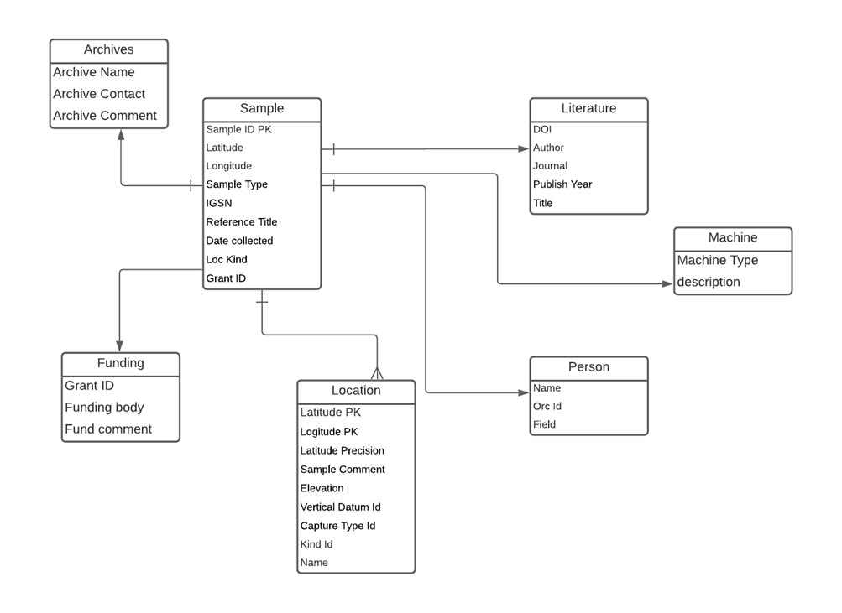
Data (Exploration & Analysis)
Data Exploration :
3152 x 59 dataset
Most columns null values, except primary columns
lat, long, lat/long precision_m, elevation_m, unit_age (min & max) and depth (min & max) - type float
Rest are type character
Data Cleaning :
Removal of duplicate entries or duplicate rows, via character match
Pair of DuplicateID & DuplicateSurvivor columns, use Duplicate survivor to get the ID’s and replace values accordingly
Data Description :
ER diagram generated based on client’s requirement schema
(Note - A sample banker dataset was also created (along with its ER schema) to test out the ETL tools features)
Notes:
Slide time (1 minute) (Kanav)

Slide 16
Testing ETL tools
Notes:
Slide time (3 seconds) (Kanav)

Slide 17
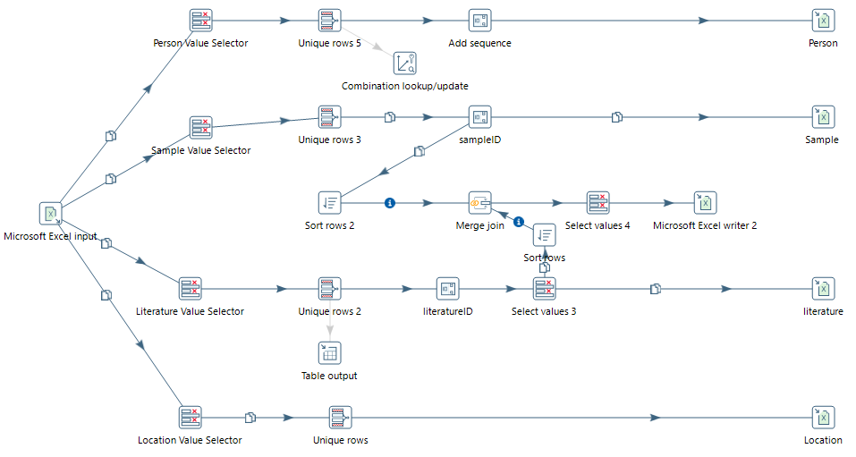
Pentaho
Notes:
Slide time (1 min) (Kanav)

Slide 18

Test (Pentaho) results & conclusion
Tests & Results:
Data transformation test
Transformed data matched business rules
Source-to-target data test
Data values match original dataset
Data Check & Constrain test
Data integrity maintained via Surrogate & Foreign keys, and referential checks passed
Regression test
Changes made to subset of flow did not affect entire flow
Conclusion:
Lacked in the following departments:
Complex flow created
Performance issues due
Not user-friendly UI
Provides custom pricing, making it costlier than Tableau-Prep
Huge application size (>2GB)
Notes:
Slide time (1 min) (Kanav)

Slide 19
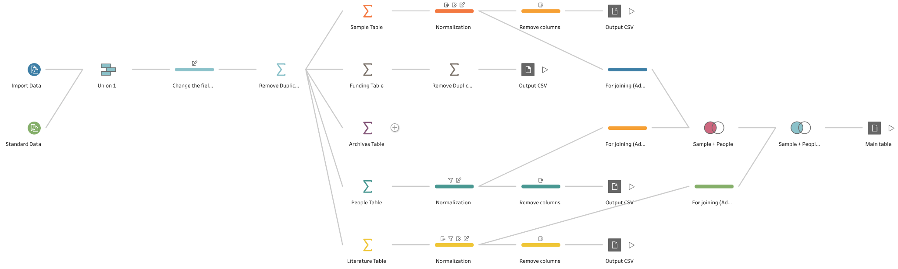
Tableau-Prep
Notes:
Slide time (1 min) (Hangzhou)

Slide 20
Test (Tableau-Prep) results & conclusion
Tests & Results:
Data transformation test
Transformed data matched business rules
Source-to-target data test
Data values match original dataset
Data Check & Constrain test
Data integrity maintained via foreign keys generated and referential checks passed
Regression test
Changes made to subset of flow did not affect entire flow
Conclusion:
Overcoming shortcomings of pentaho by following:
Simpler easy to create/understand flow
Minimum execution time - optimized flow
User-friendly UI with shallow learning curve
Cheaper subscription than Pentaho
Small application size
Notes:
Slide time (1 min) (Hangzhou)
(After talking about the results of tableau prep test)
Based on the testing of these two softwares for pipelines built on sample & client dataset, and testing of two other trivial data engineering tools that are - MS Excel and Google sheets, it was concluded that Tableau Prep was the best tool to go ahead with as it provides code free, user friendly UI, easy to understand and direct connection to RDBMS solution. Which exactly matches the clients requirements.

Slide 21
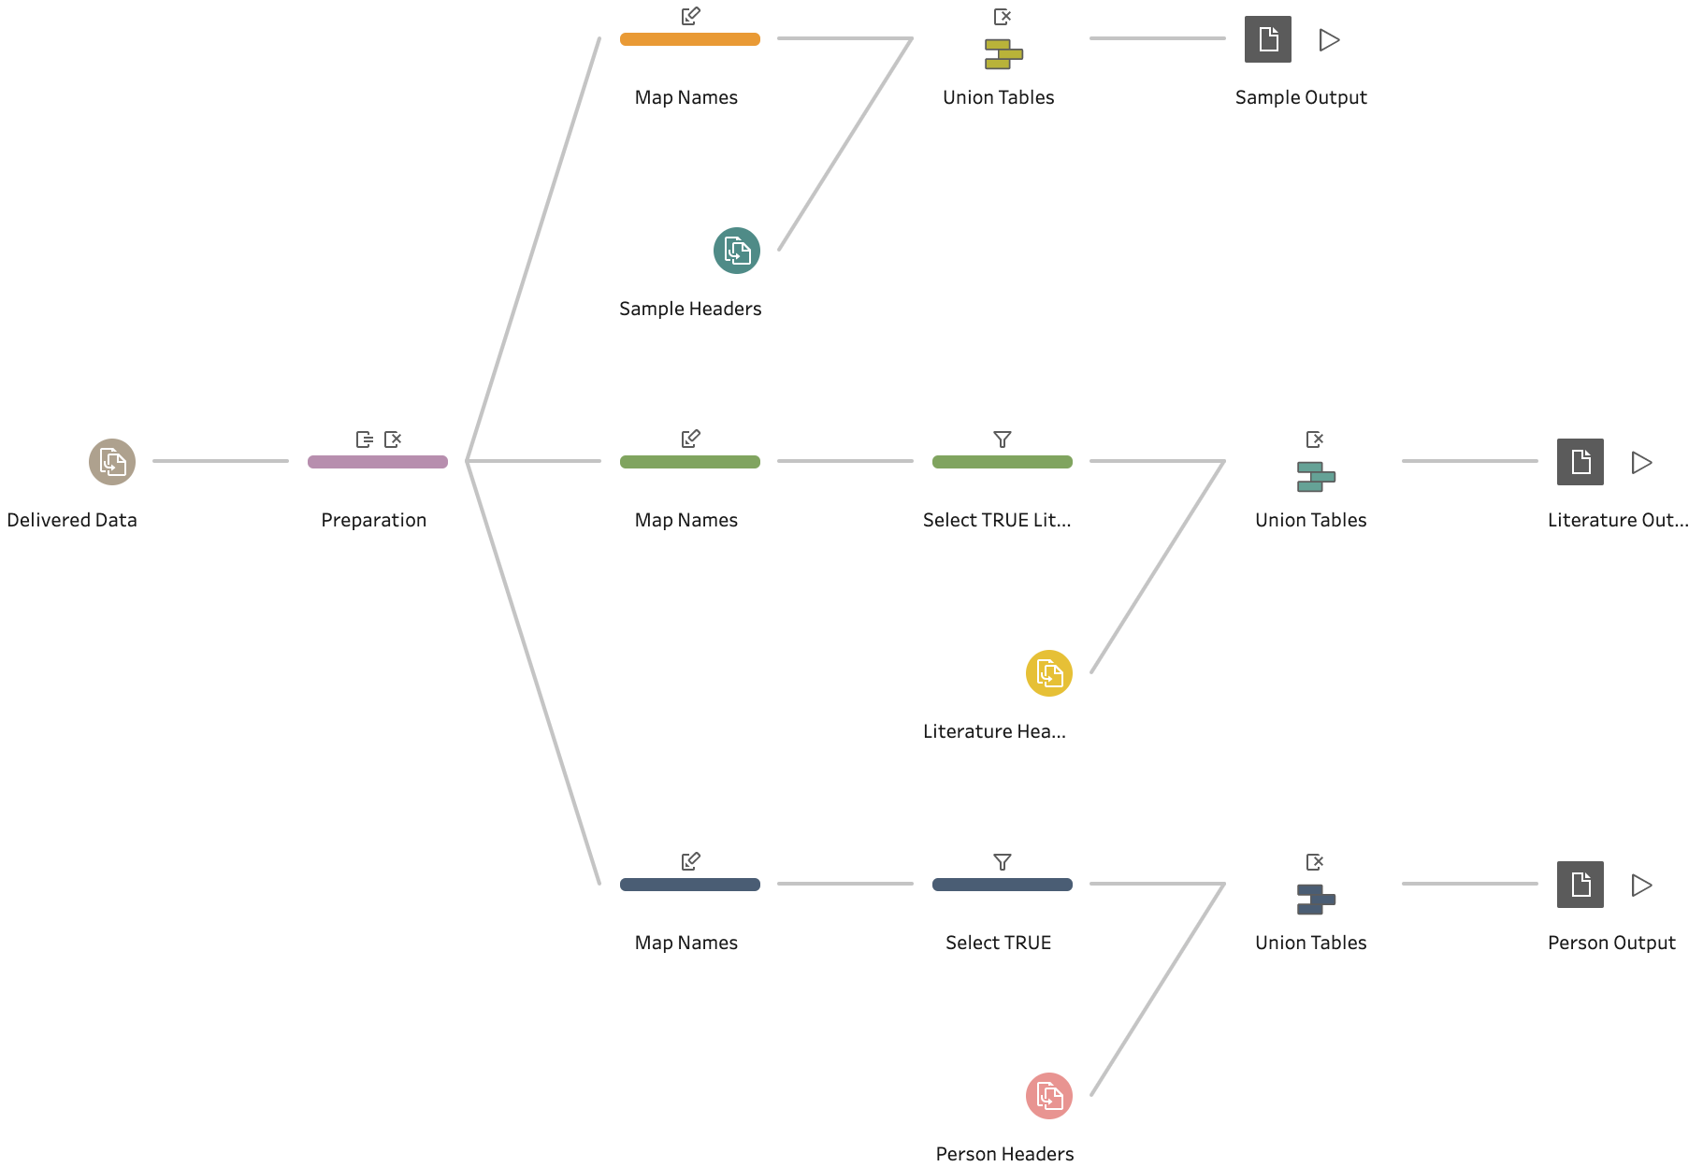
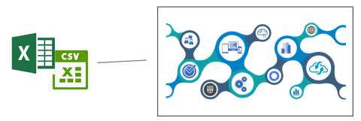
ETL Pipeline designed for the client
Transformation :
Loading:
Extraction :
Lithosurfer
DB
Lithodat Website
Notes:
Slide time (1.5 min) (Hangzhou)
Talk about the extraction, transformation and loading stage from section 6 of the final report
(extraction - talk about how unstructured or non-normalized data islegacy data i.e. data collected from various researchers or laboratory networks. This data is in the form of Tables stored in CSV (comma separated) or xlsx (MS Excel) format. This collected data is then unified into a single excel worksheet upon which the next step of the ETL process)
(transformation - talk about the flow, not in superdetail, becz you have already done that in slide 17, so maybe only tell briefly about what is happening)
(loading - talk about lithosurfer, and how transformed data can be loaded in the following way
1. Create a data package if not created, to store the data inside it
2. Import the People, Literature, Archives, Reference, Machine, and Funding data into their respective section in the Related Data tab
3. Import the Sample data into its section in the Main Data section
After uploading the sample data, Lithosurfer can automatically detect the links between the rows inthe Sample section and the rest of the data, and if any data is not correctly linked with the rest of thesections entries while importing the sample data, an error is shown for the respective entry which canbe resolved by clicking on it and choosing an appropriate value matching with it.)

Slide 22
Conclusion & Recommendations
Tableau Prep perfect for client requirements
Client implemented the final pipeline for their workflow
Loading stage is semi-automated
Limitations of the tests conducted
Only software based tools considered
Tests conducted only on sample banker dataset and client dataset
Simpler ETL flows prefered over complex
No data preprocessing before performing ETL
Recommendations
Test ETL pipeline on another dataset
Support Data Loading stage to more than 50 rows
Extend flow for funding and archives sub-tables
Notes:
Slide time (1 min) (Hangzhou)
The Conclusions are as follows:
ETL for geodata is on the rise due to its vaste availability and the need to unify them to one location or database
The final ETL pipeline discussed earlier has now been implemented by the client in their workflow
As this is not entirely an automated pipeline, only the loading stage of the pipeline remains semi-automated
Although rigorous test were conducted according to the literature review, some limitations are :
Due to clients requirements, only software based tools were tested on client data
The sample banker dataset and client dataset do not represent all the types of dataset that can be tested
Simpler ETL flows were preferred over complex ones
Raw data was used to test out the ETL flows
Some of the recommendations which were made to the clients are:
To test out the pipeline on another geo-dataset
To extend the flow for funding and archives subtables
And support data loading for more data with more than 50 rows

Slide 23
Thank You
Notes:
Slide time (5 seconds) (Hangzhou)

